Slide 1
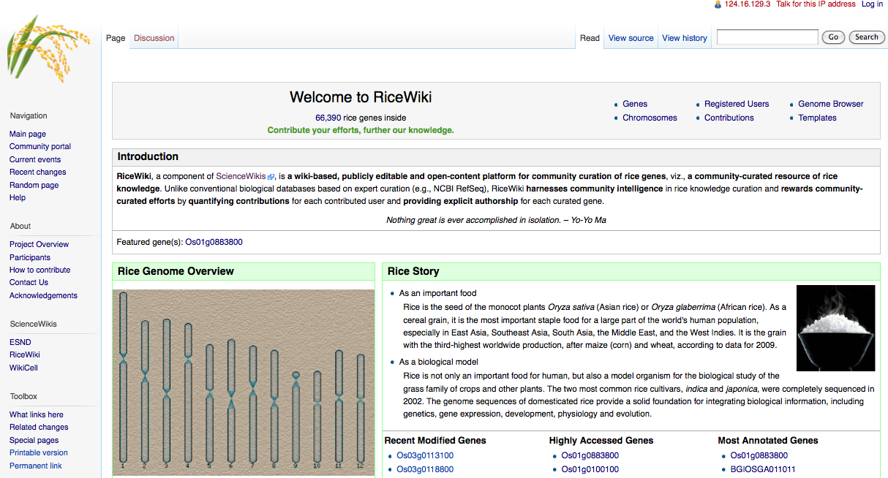
RiceWiki: a wiki-based database for community curation of rice genes
Available at http://ricewiki.big.ac.cn

Slide 2
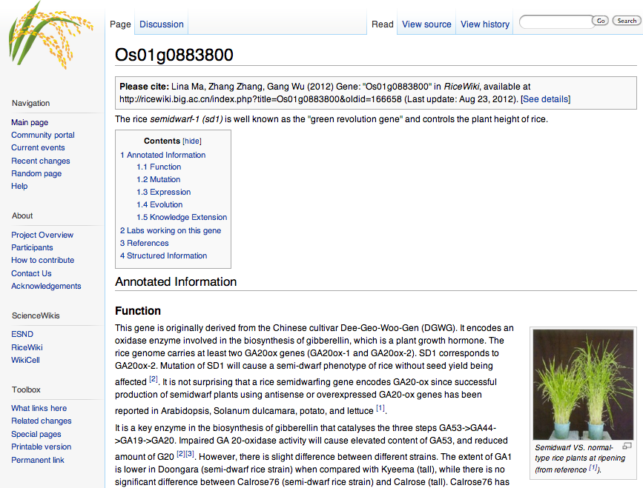
Community curation of the sd1 gene
Reward community-curated efforts
Available at http://ricewiki.big.ac.cn/index.php/Os01g0883800

Slide 3
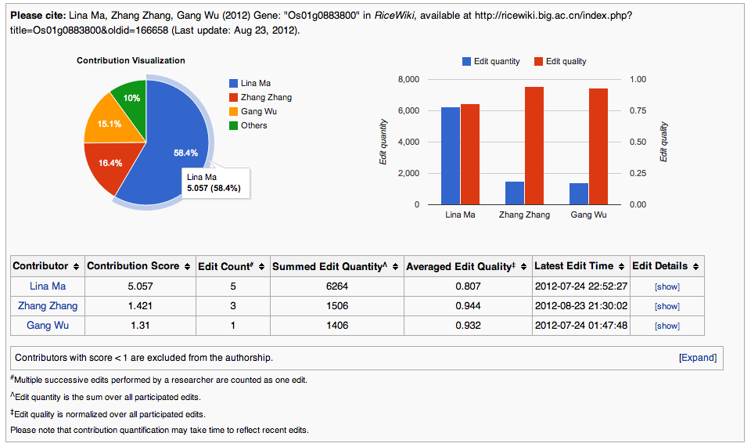
Authorship quantification and visualization of community-curated efforts on the sd1 gene
Available at http://ricewiki.big.ac.cn/index.php/Os01g0883800#AuthorReward

Slide 4
Student assignment
Visit RiceWiki at http://ricewiki.big.ac.cn
Open an account in RiceWiki by contacting the RiceWiki Team at ricewiki@big.ac.cn , to tell us your preferred login name, real name, research interests, etc.
Perform curations on rice genes:
N students forming a group collaborate to curate N genes, where N >= 3.
Contribution score >= 1.
Example: http://ricewiki.big.ac.cn/index.php/Os01g0883800
In life sciences, curation involves the translation and integration of information relevant to biology into a database or resource that enables integration of the scientific literature as well as large data sets. Accurate and comprehensive representation of biological knowledge, as well as easy access to this data for working scientists and a basis for computational analysis, are primary goals of biocuration. More information can be available at http://www.biocurator.org.

